Slide 2
PN3322: AI and ”Big” Data

Slide 3
What is Big Data/AI?

Slide 4
What is “big data”?
No Single Definition. Big data is the term for a collection of data sets so large and complex that it becomes difficult to process using on-hand database management tools or traditional data processing applications.
"Big Data are high-volume, high-velocity, and/or high-variety information assets that require new forms of processing to enable enhanced decision making, insight discovery and process optimization” (Gartner 2012)

Slide 5
Neural Systems Process information
1st: What is Information?
Claude Shannon in 1949 created the mathematical definition of information.
Equating statistics of possibilities with information.
Creating the “bit” as a measure

Slide 6
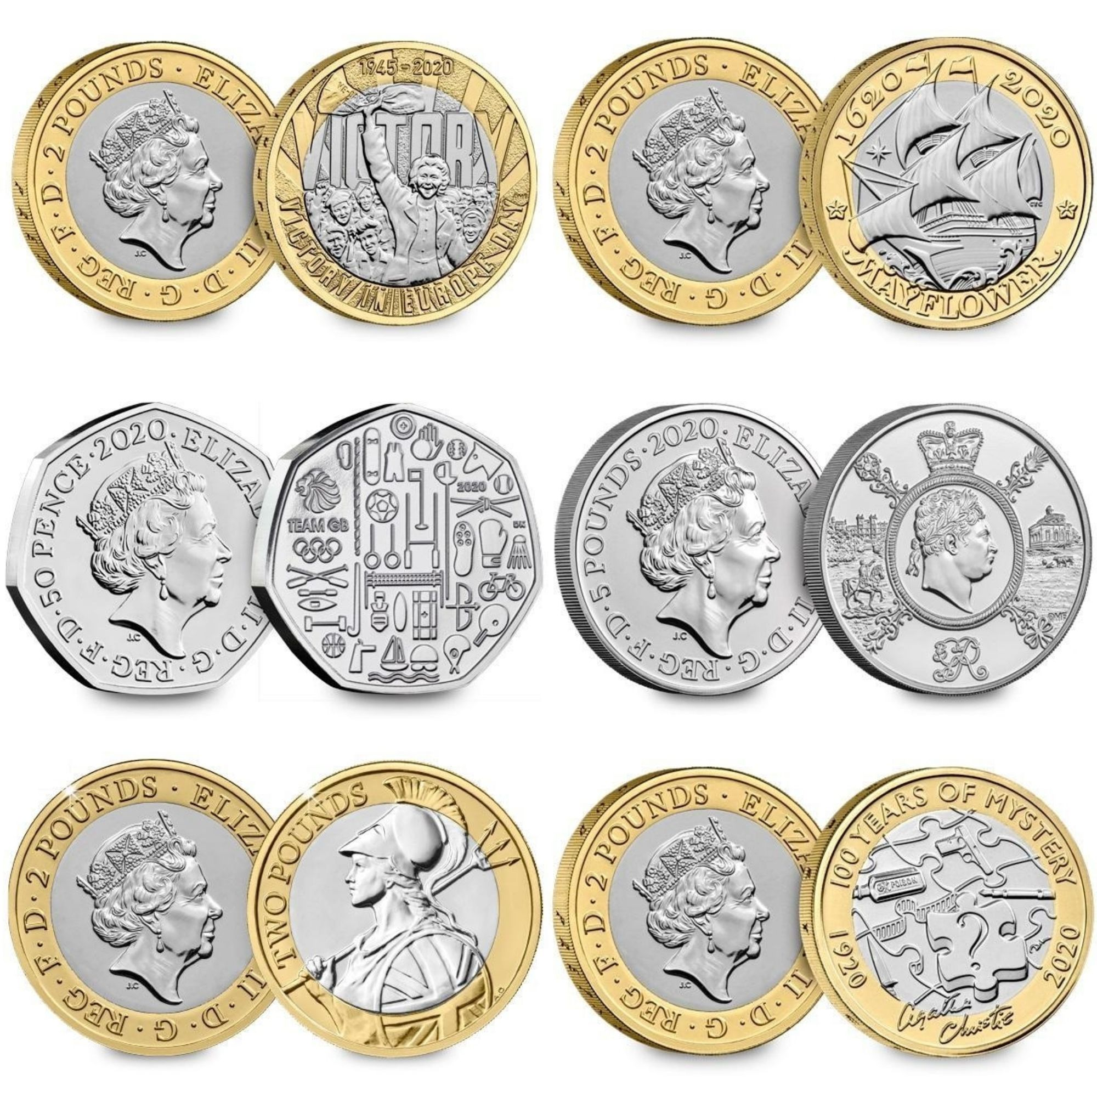
A coin flip can take 2 states: heads/tails
This is 1 bit of information

Slide 7
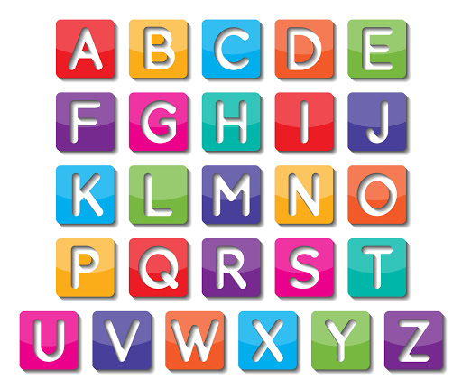
The alpha has 26 letters
This is 4.7 bits of information

Slide 8
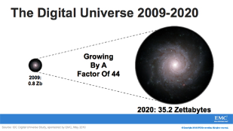
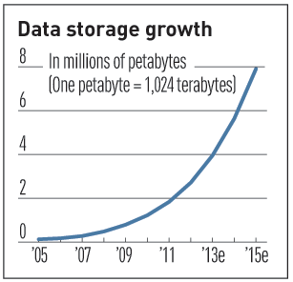

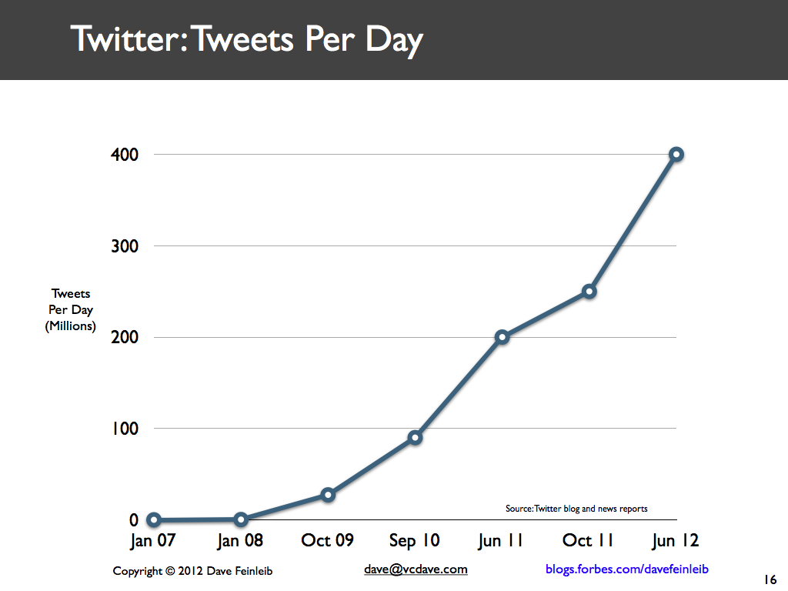
Volume (Scale)
Data Volume
44x increase from 2009 2020
From 0.8 zettabytes to 35zb
Data volume is increasing exponentially
Exponential increase in collected/generated data

Slide 9
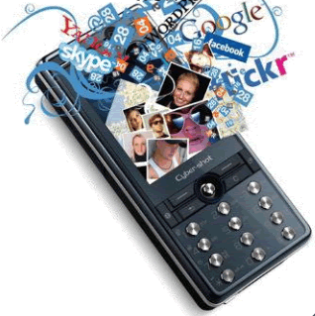
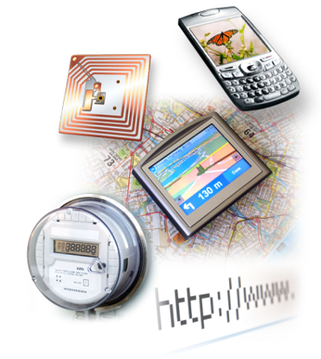

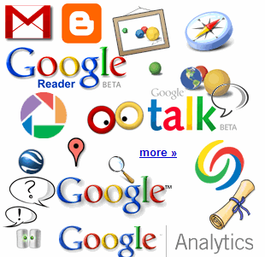

4.6 billion camera phones world wide
30 billion RFID tags today (1.3B in 2005)
12+ TBs of tweet data every day
100s of millions of GPS enabled devices sold annually
? TBs of data every day
25+ TBs of log data every day
2+ billion people on the Web by end 2011
76 million smart meters in 2009… 200M by 2014

Slide 10
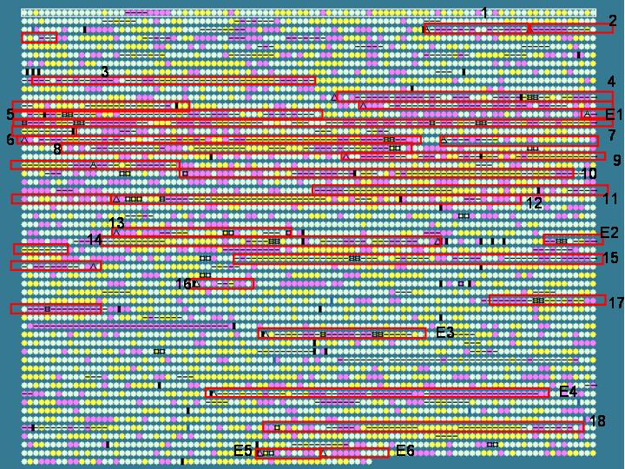
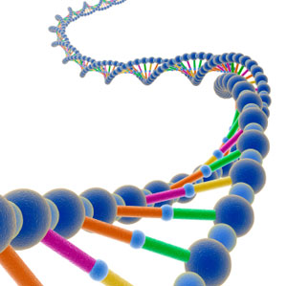
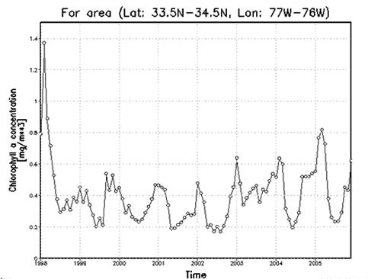
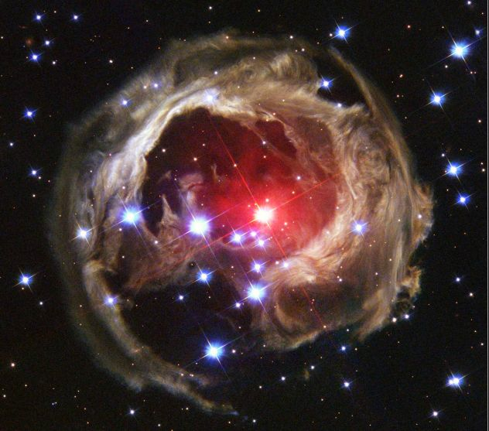
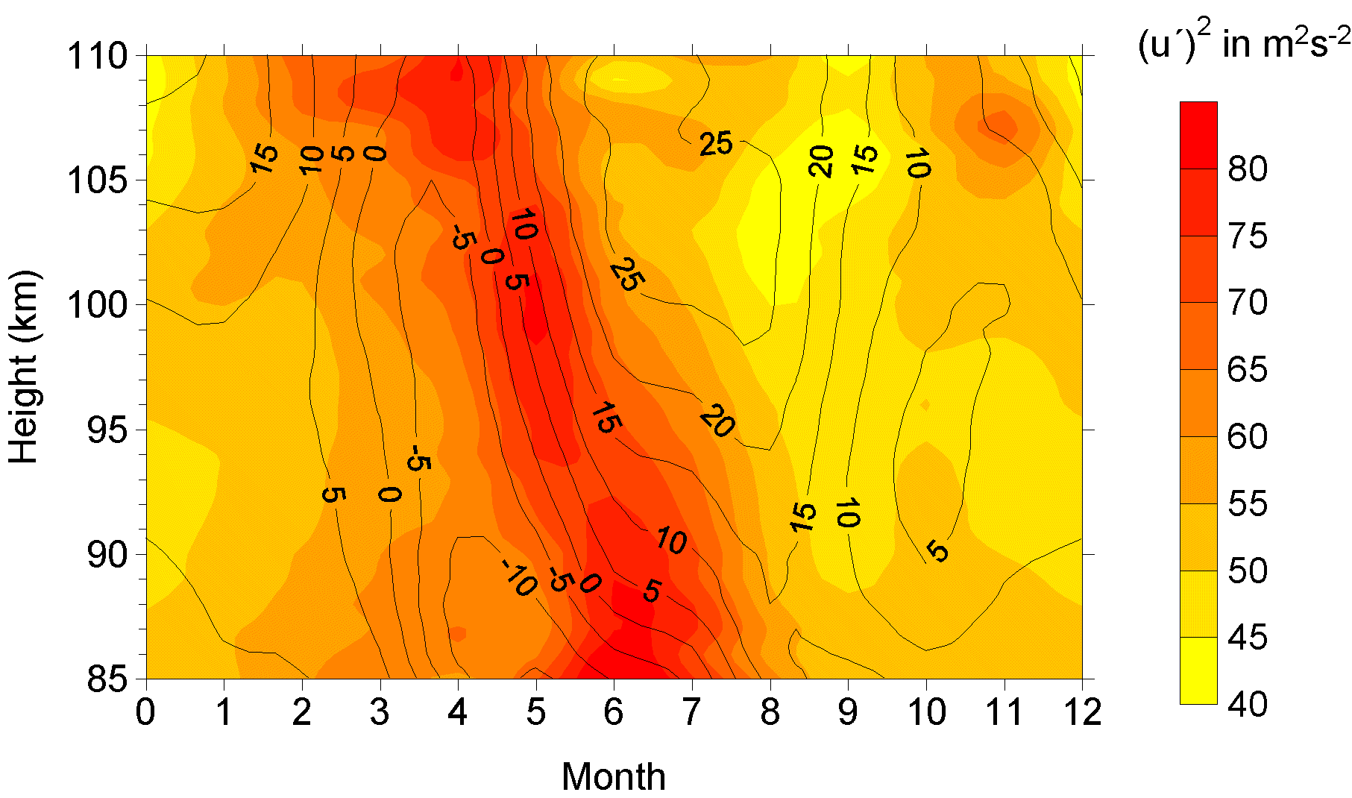
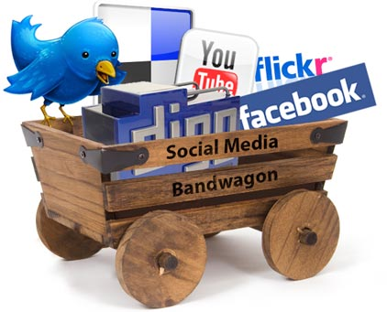
Variety (Complexity)
Relational Data (Tables/Transaction/Legacy Data)
Text Data (Web)
Semi-structured Data (XML)
Graph Data
Social Network, Semantic Web (RDF), …
Streaming Data
You can only scan the data once
A single application can be generating/collecting many types of data
Big Public Data (online, weather, finance, etc)
To extract knowledge➔ all these types of data need to linked together

Slide 11
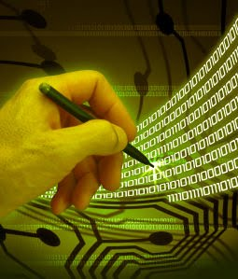
Velocity (Speed)
Data is begin generated fast and need to be processed fast
Online Data Analytics
Late decisions ➔ missing opportunities
Example
Healthcare monitoring: sensors monitoring your activities and body ➔ any abnormal measurements require immediate reaction

Slide 12
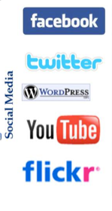
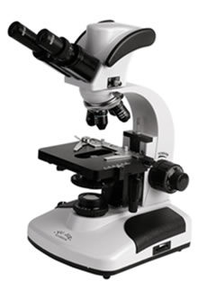

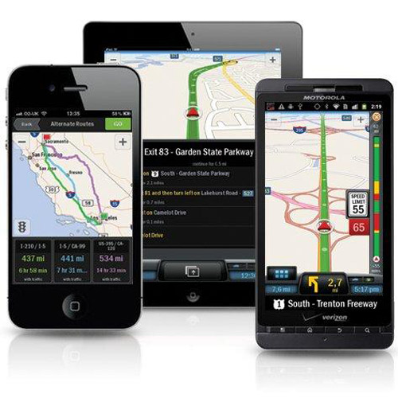
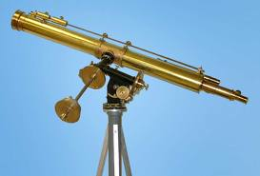
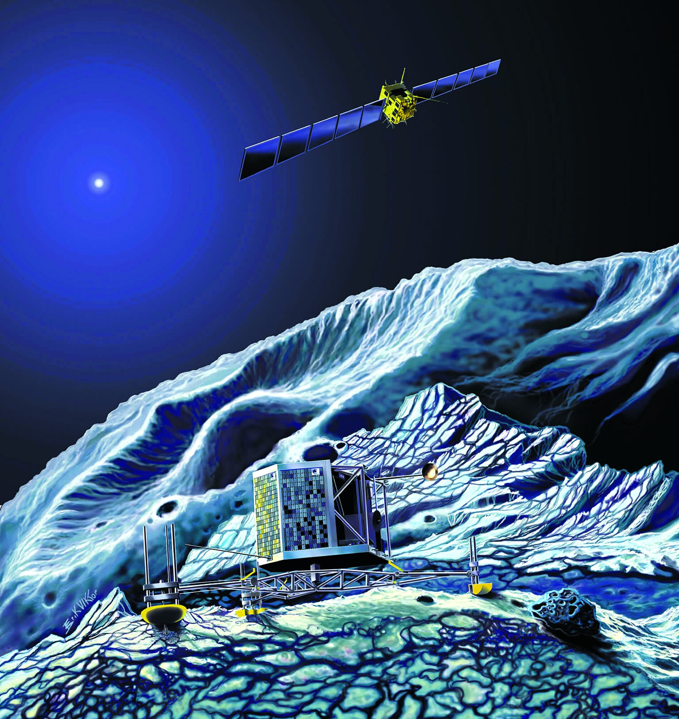
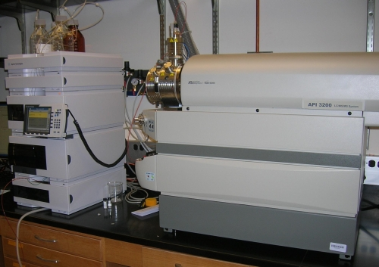
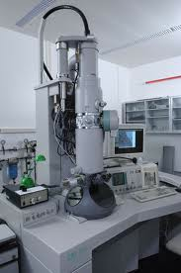
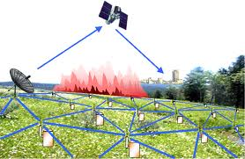
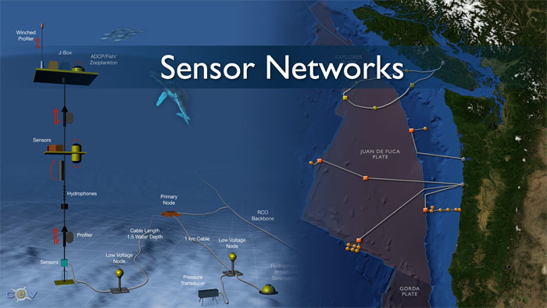
Real-time/Fast Data
Mobile devices
(tracking all objects all the time)
Social media and networks
(all of us are generating data)
Scientific instruments
(collecting all sorts of data)
Sensor technology and networks
(measuring all kinds of data)

Slide 13
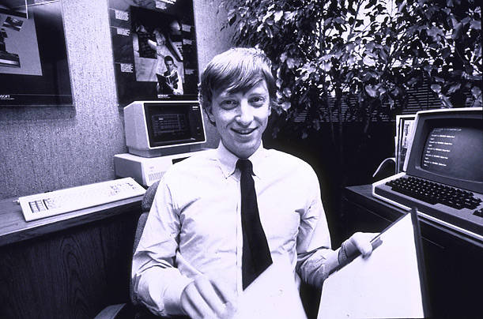
How much data?
Google processes 20 PB a day (2008)
Wayback Machine has 3 PB + 100 TB/month (3/2009)
Facebook has 2.5 PB of user data + 15 TB/day (4/2009)
eBay has 6.5 PB of user data + 50 TB/day (5/2009)
CERN’s Large Hydron Collider (LHC) generates 15 PB a year
640K ought to be enough for anybody.

Slide 14
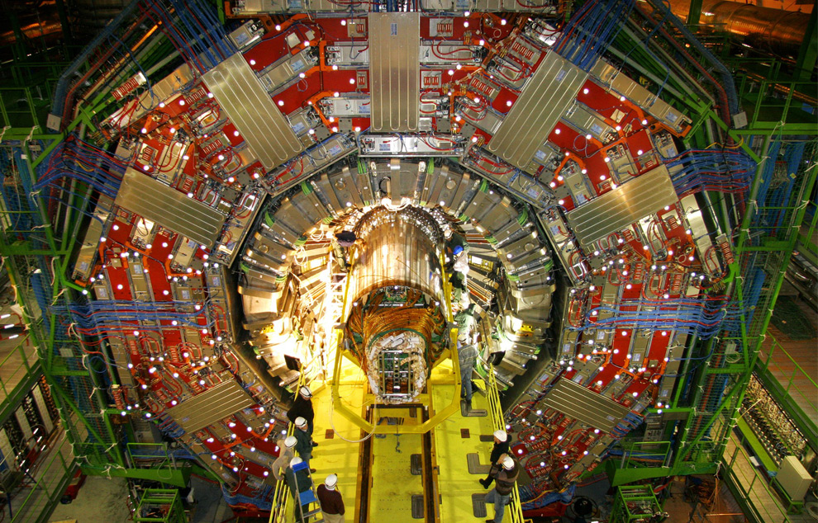
Maximilien Brice, © CERN

Slide 15
Maximilien Brice, © CERN

Slide 16
Neuroscience has LOTS of examples

Slide 17
Neuroscience has LOTS of examples
For both:
Understanding how the brain works
Creating “artificial intelligence” algorithms

Slide 19
Human Brain has been estimated to encode 2.5 PETABYTES.
That’s 2.5 MILLION Gigabytes

Slide 20
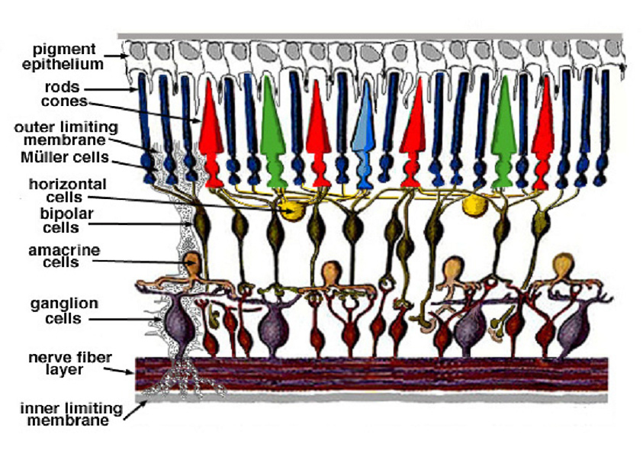
~120 Million rods, and 6 Million Cones
Each signalling changes on the order of 10-100 ms

Slide 21
Information
Vision alone gives your brain about 10 Million bytes per second!
(* A ”byte” is 8 bits)
But it has been suggested that your conscious perception is ~5 bytes per second (Zimmerman 1989).
That’s Not 5 Million
5.
Every second millions of bytes of information are compressed down to 5.

Slide 22
So What is Big Data/AI?
It’s fundamentally about extracting the most important information from DATA

Slide 23
Making decisions from data

Slide 24
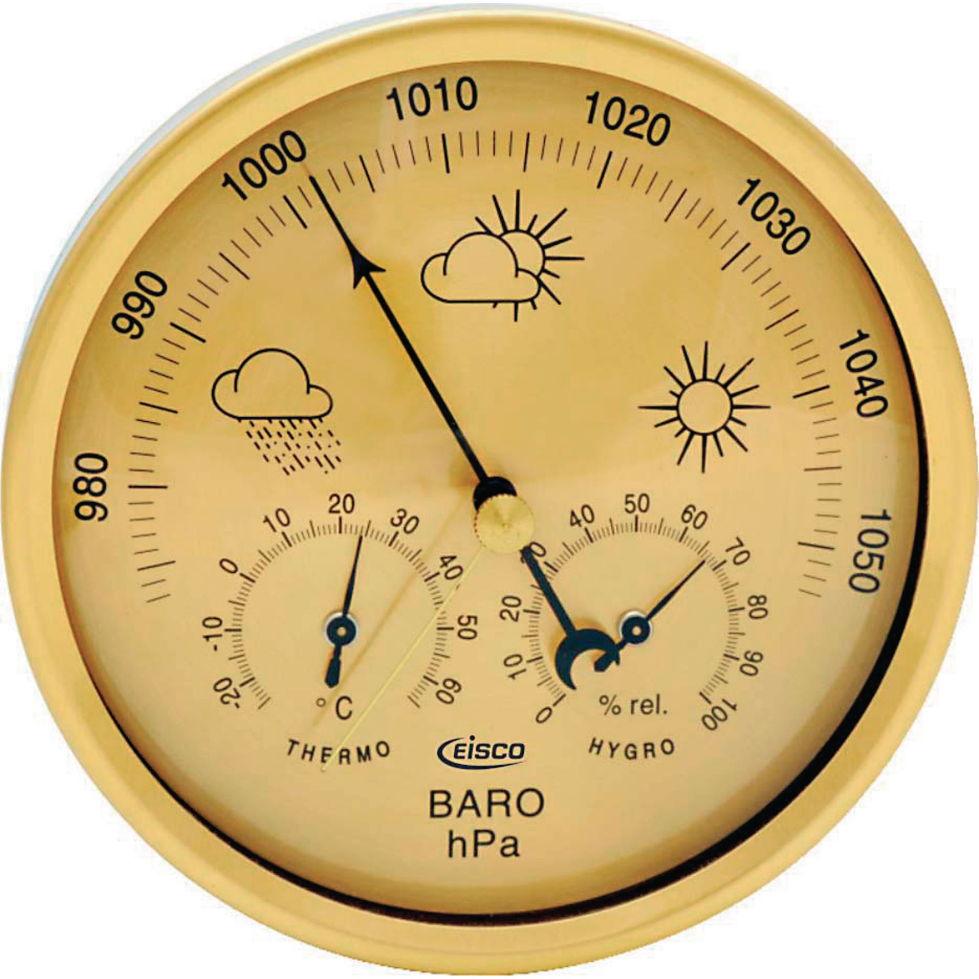

Slide 25
Making decisions from data

Slide 26
Uncertainty People are good at variance bad at bias

Slide 27
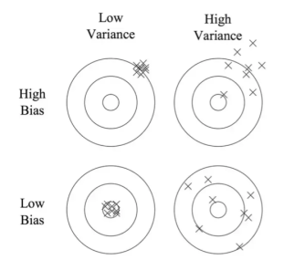
Bias/Variance Trade off:

Slide 28
We often don’t know the target
The calibration problem.

Slide 29
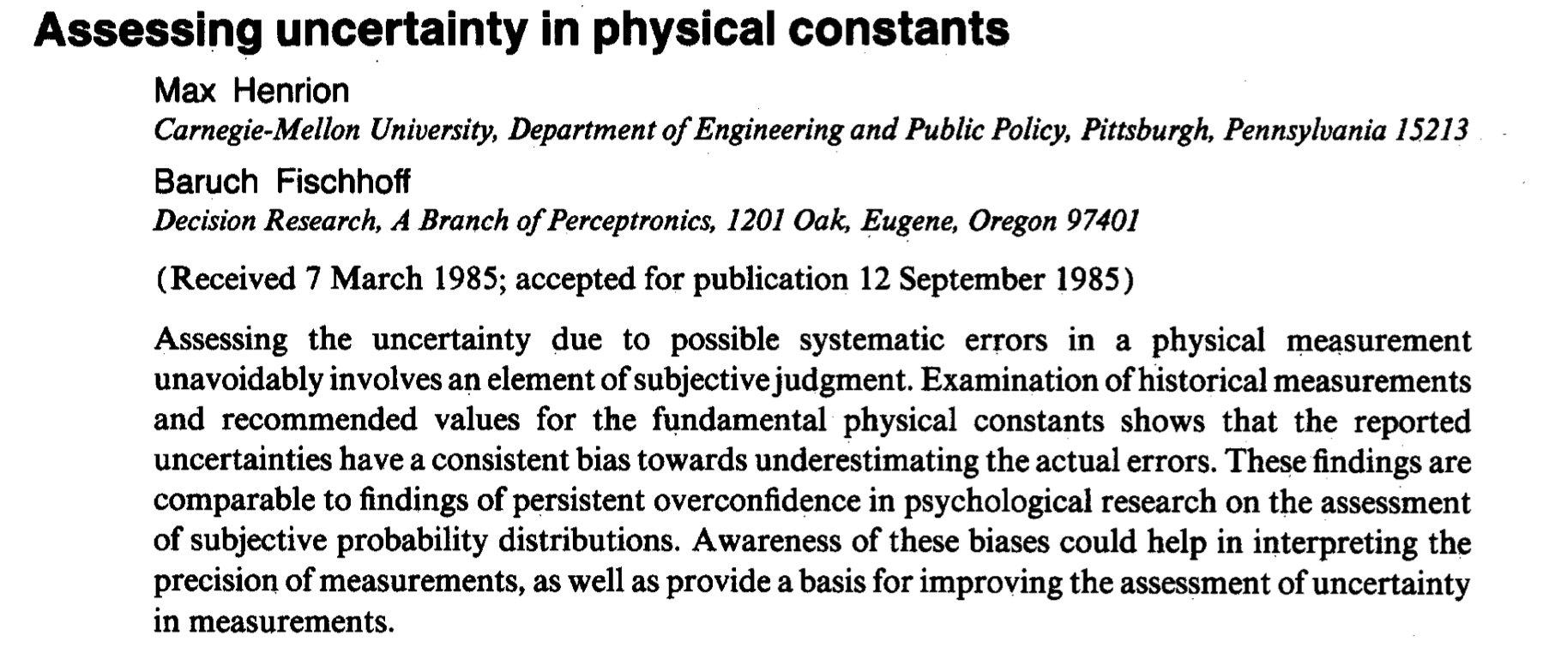
Miscalibration in physics:

Slide 30
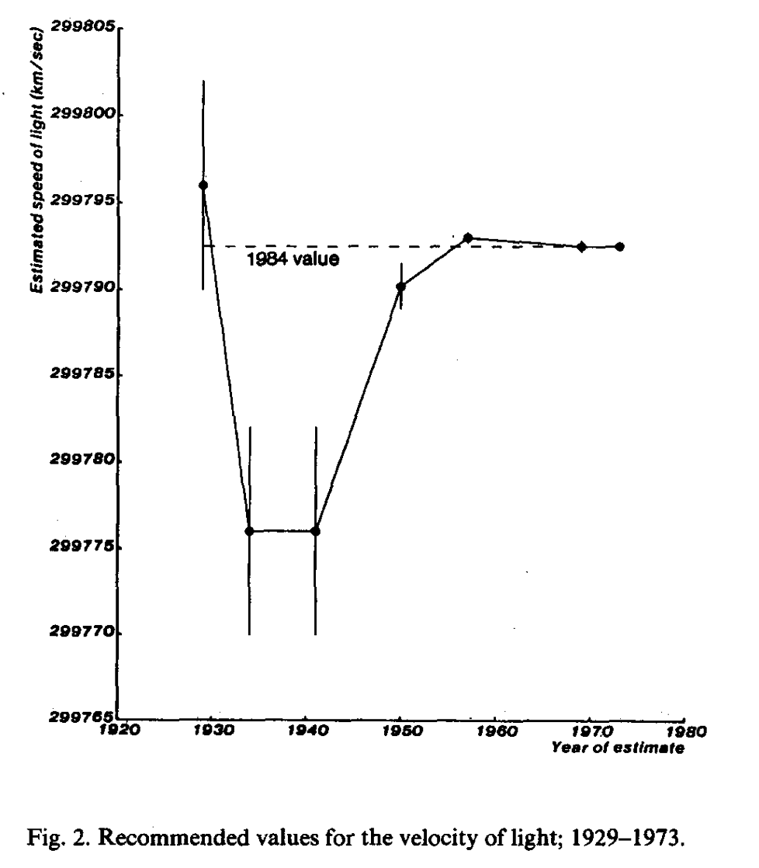

Slide 31
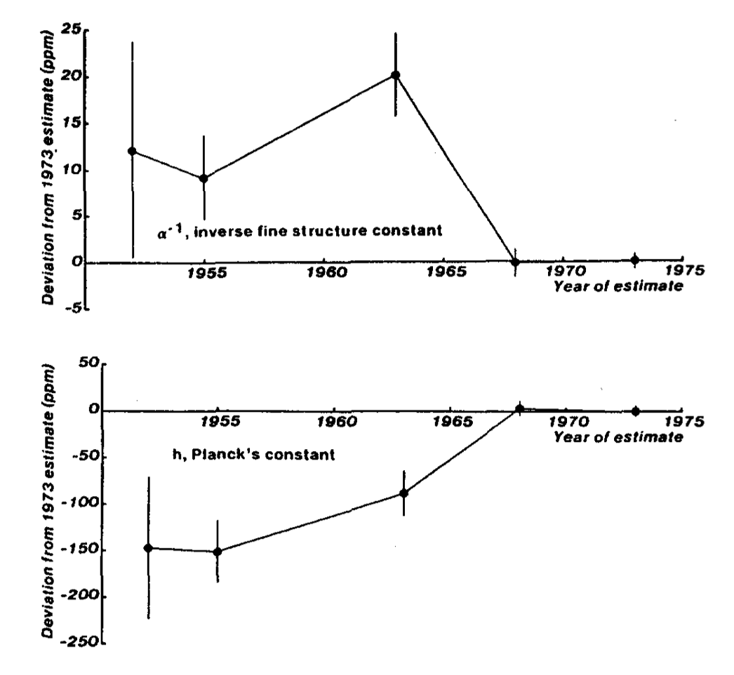

Slide 32
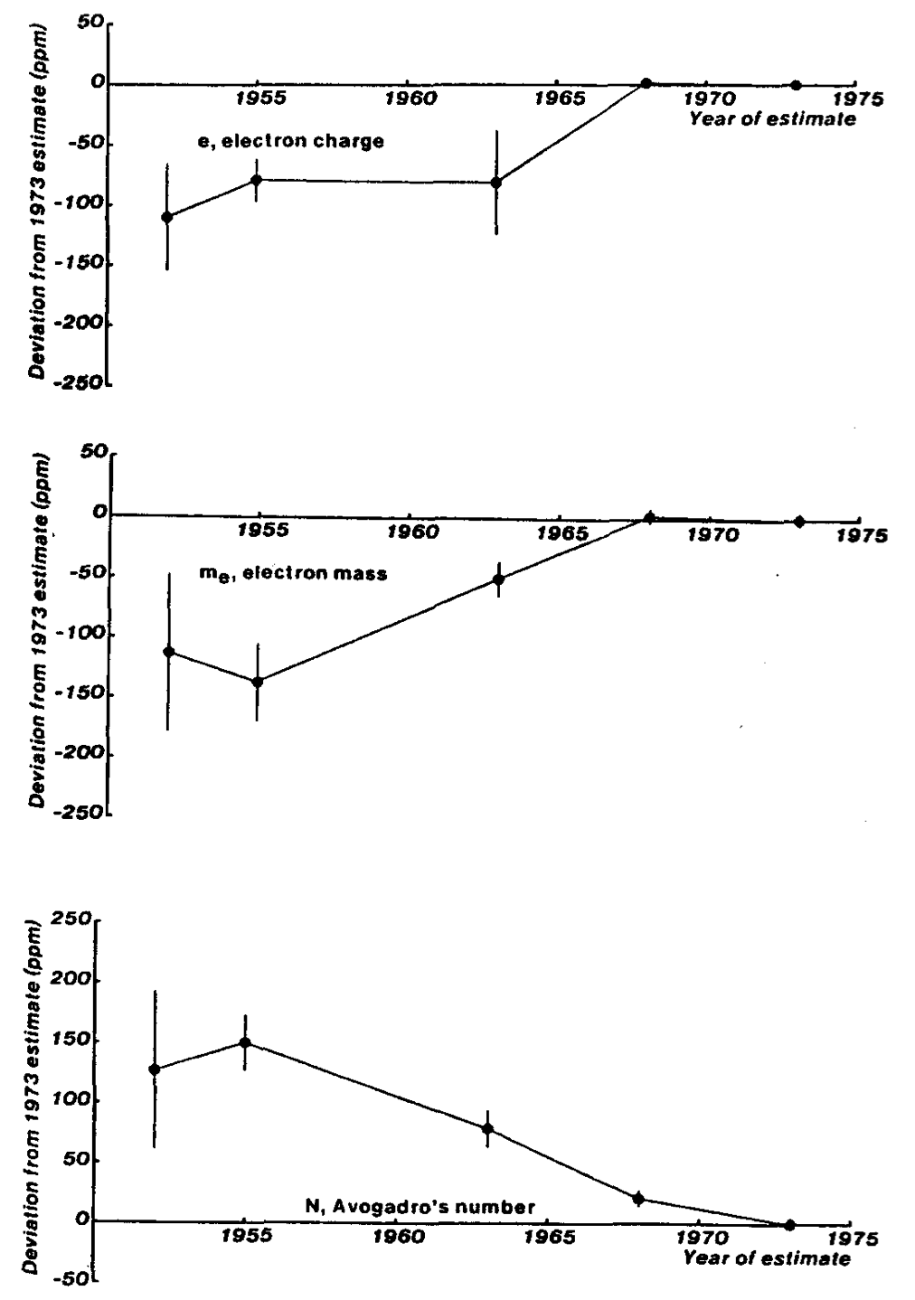

Slide 34
Consequences of miscalibration

Slide 35
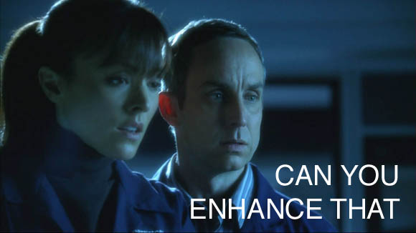

Slide 36
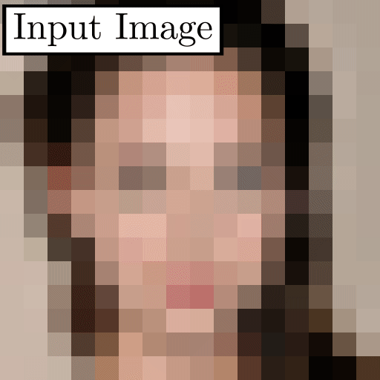
https://github.com/tg-bomze/Face-Depixelizer

Slide 37


Slide 38
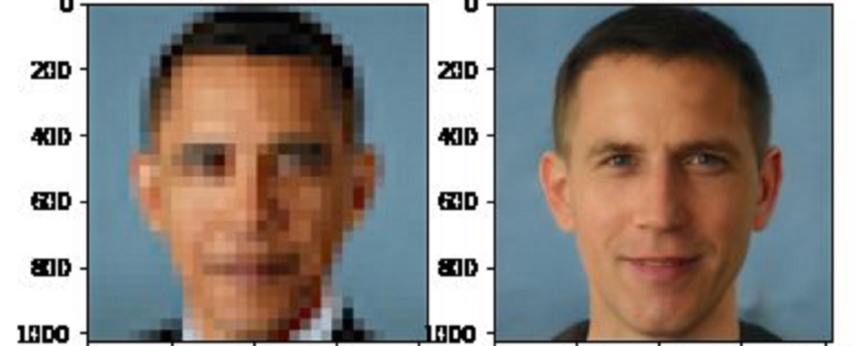

Slide 40
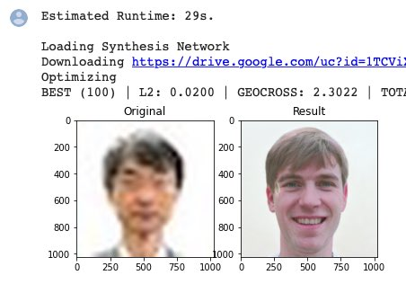

Slide 41
Assessing risk, automating racism
- Ruha Benjamin

Slide 42
COMPAS
Correctional Offender Management Profiling for Alternative Sanctions

Slide 43
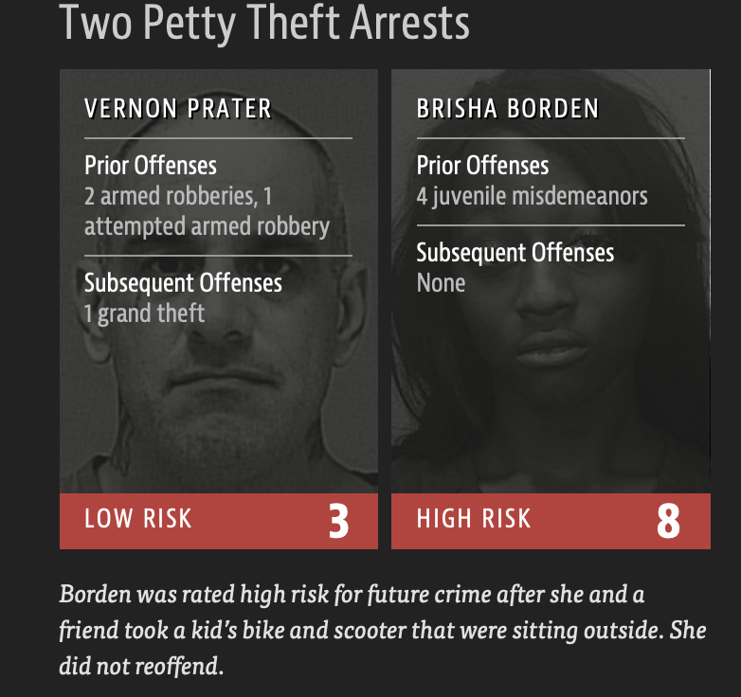

Slide 44
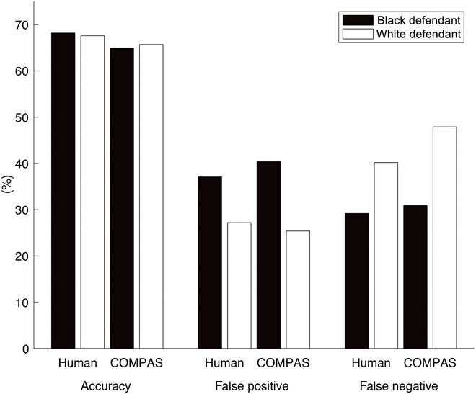

Slide 49
Algorithmic Healthcare

Slide 50
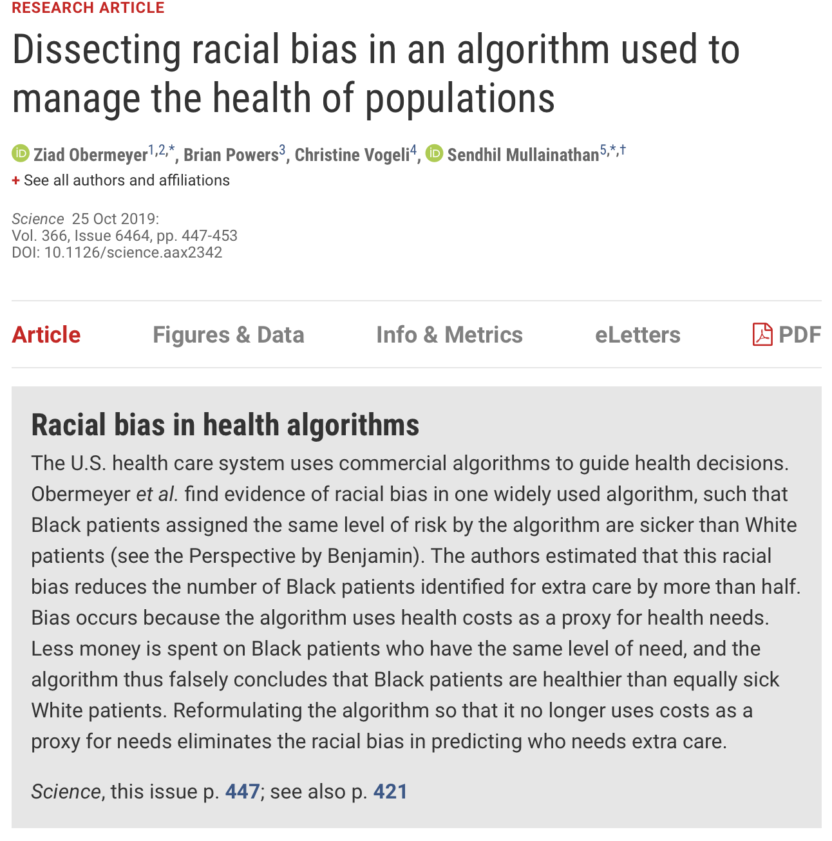

Slide 51
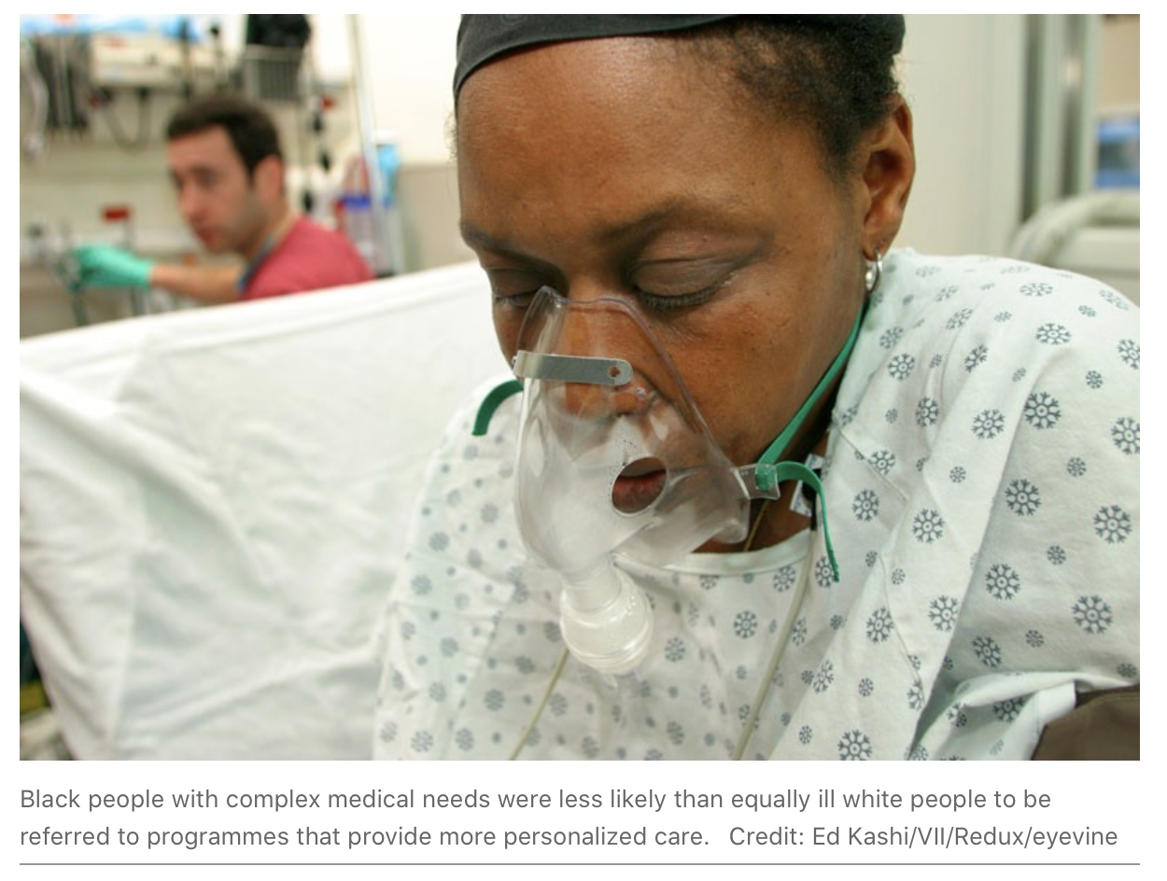

Slide 52
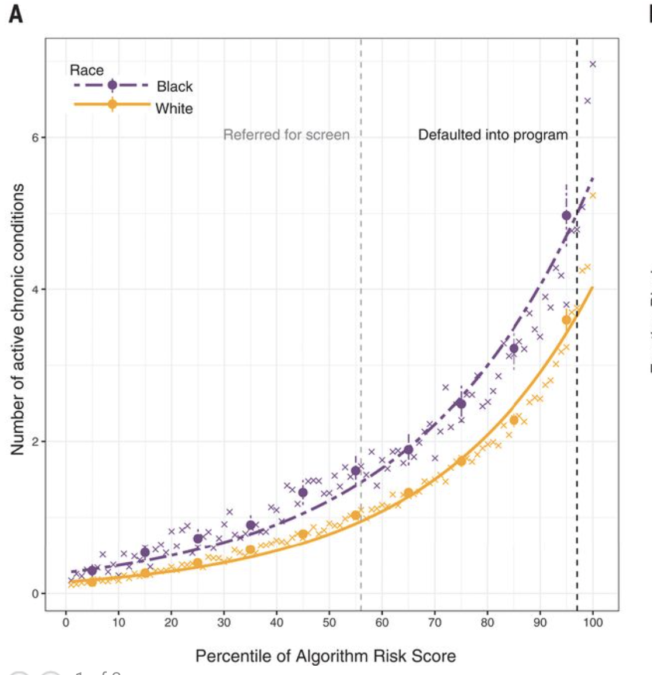

Slide 54
They found that because the tool was de- signed to predict the cost of care as a proxy for health needs, Black patients with the same risk score as White patients tend to be much sicker, because providers spend much less on their care overall.

Slide 57
The Paradox of big data

Slide 58
The more the data, the surer we fool ourselves.

Slide 59
The more the data, the surer we fool ourselves.
Or: Quantity is not a substitute for quality

Slide 61
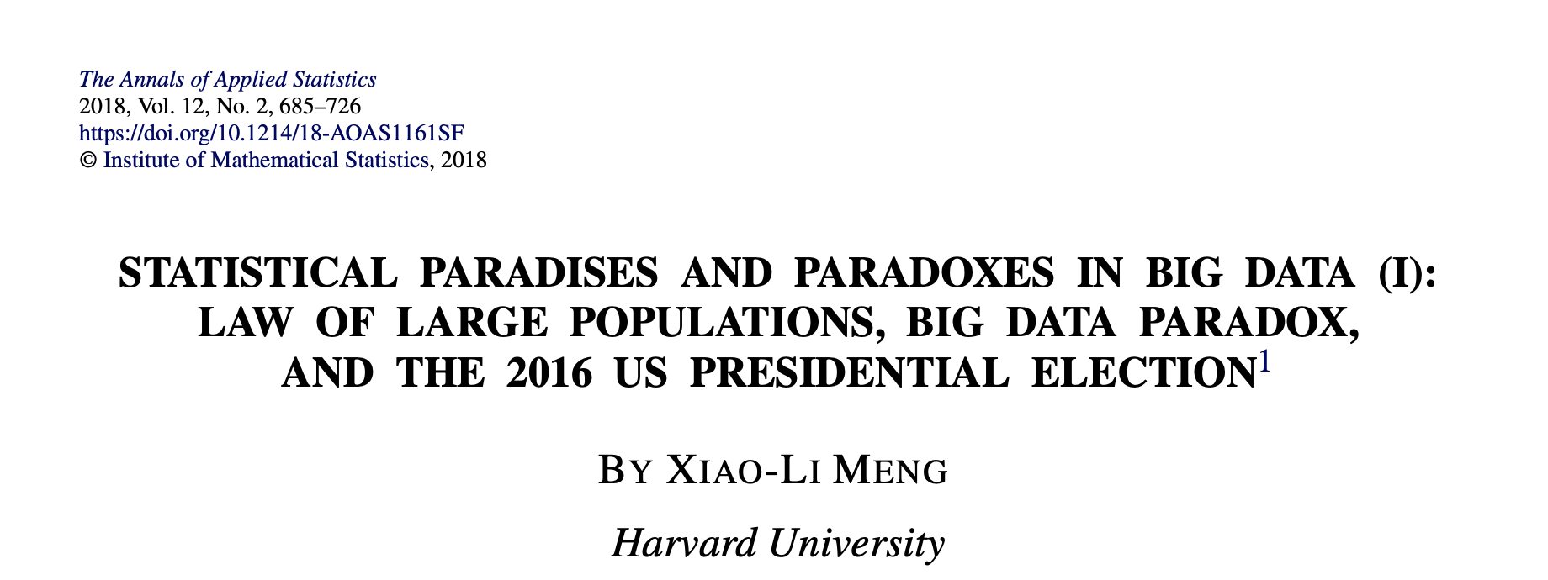

Slide 62
What should you trust more for a poll?
A survey with 2,300,000?
A survey with 400?
Yes, it’s a trick question.
If there’s just a 0.005 correlation between responding and your choice
A truly random survey of 400 is as accurate as a biased survey of 2,300,000

Slide 63
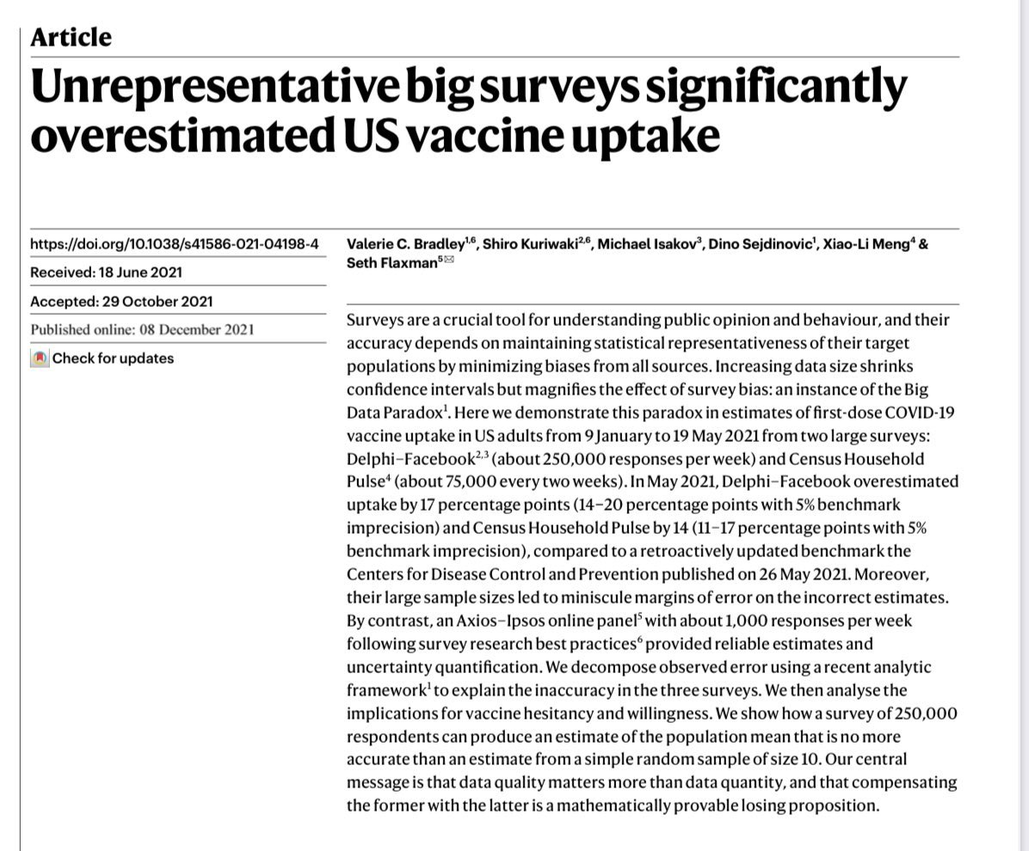

Slide 64
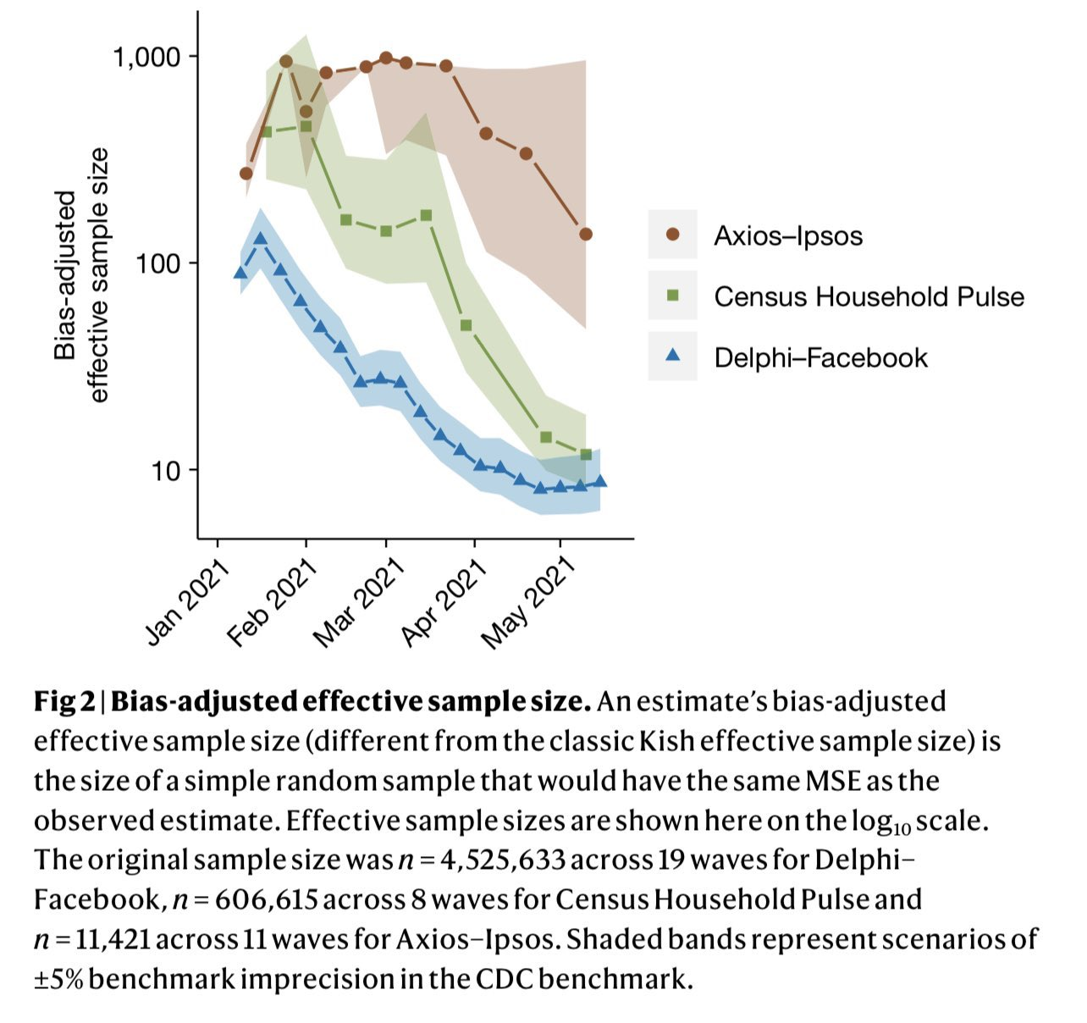

Slide 65
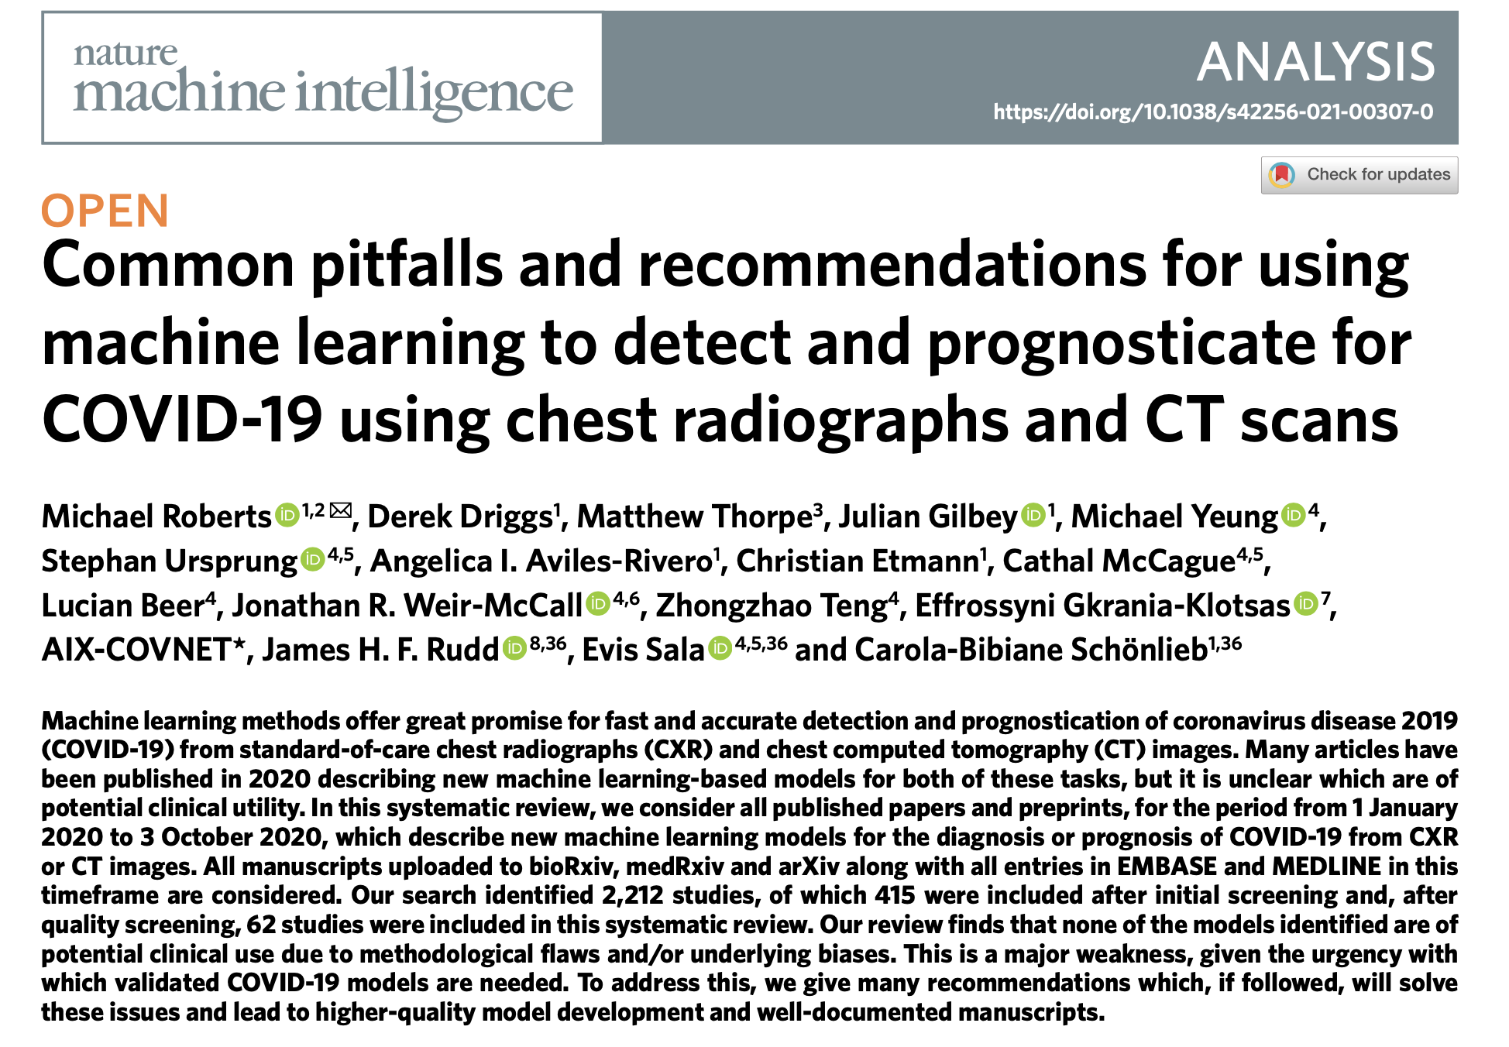

Slide 66
Many papers (16/62) used the pneumonia dataset of Kermany et al. as a control group. They commonly failed to mention that this consists of paediatric patients aged between one and five. Developing a model using adult patients with COVID-19 and very young patients with pneumonia is likely to overperform as it is merely detecting children versus adults.

Slide 67
Our review finds that none of the models identified are of potential clinical use due to methodological flaws and/or underlying biases.

Slide 68
Is this a problem for Neuroscience?

Slide 69
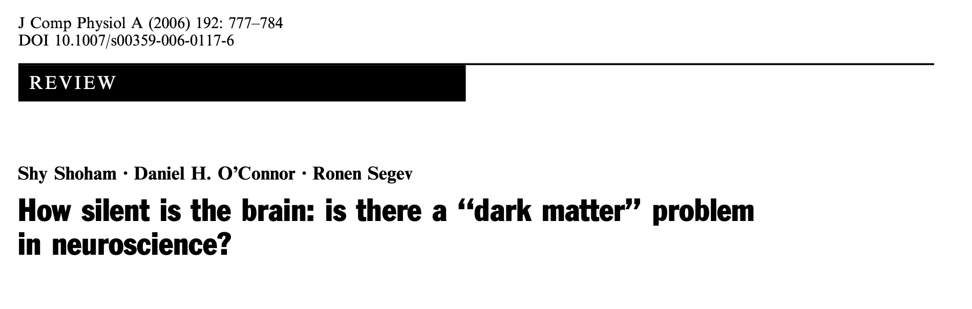

Slide 70
The most common measurement is microelectrodes
People have noticed that fewer neurons are found than should be
Robinson (1968) expected 100 and only found a few.
Data suggest 90% of neurons aren’t measured from!

Slide 71
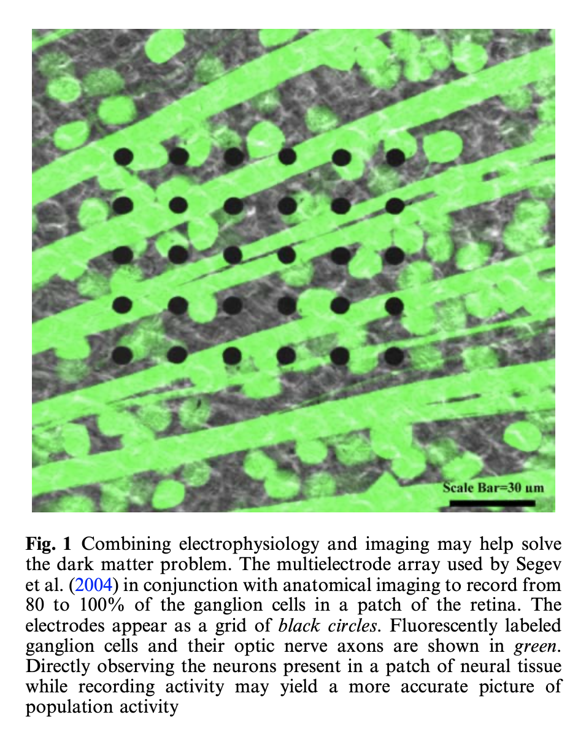

Slide 72
Generative AI

Slide 74


Slide 75
